Slide 1
Responsibility for Alaska’s Future

Slide 2
Who We Are
A 501(c)(6) organization led by founding Director Carl Marrs, CEO of Old Harbor Native Corp. and former CEO of CIRI
Alaskan businesses, unions, Native leaders and individuals who care about the economic future of our state
About Us – Who We Are

Slide 3
Our Mission
The mission of Alaskans for Common Sense is to support responsible and sustainable Permanent Fund policies to:
Avoid unnecessary taxes on Alaska’s businesses and individuals
Provide an affordable Permanent Fund Dividend without overspending the annual 5% POMV (Percent of Market Value) draw
Maintain essential state services
About Us – Our Mission

Slide 4
Why We’re Here
We support the largest dividend the state can responsibly afford by following disciplined guidelines to ensure sustainability
Alaska’s Permanent Fund is the envy of any other state. If managed responsibly, the Permanent Fund will fund our present needs, as well as the needs of future generations, indefinitely
Oil revenue largely funded the state of Alaska for nearly five decades, but oil revenue can no longer support it alone
About Us – Why We’re Here

Slide 5
Three Keys to Fiscal Responsibility
Avoid unnecessary taxes
Don’t overdraw the Permanent Fund
Maintain Essential Services & Infrastructure
Three Keys to Fiscal Responsibility

Slide 6
1. Avoid Unnecessary Taxes
Do not increase taxes on our resource industries, businesses or individuals that threaten investment, economic development and prosperity for Alaskans
Additional taxes could be needed to support essential services in the future, but it would make no sense to impose taxes simply to pay out an unsustainable dividend
Three Keys to Fiscal Responsibility – Avoid Unnecessary Taxes

Slide 7
2. Don’t Overdraw the Permanent Fund
Do not overspend the annual 5% POMV (Percent of Market Value) draw from the Permanent Fund
This 5% allowable draw is the law and is an effective spending limit on government services and the dividend
Overdrawing the fund is reckless and dangerous. It reduces long-term earnings and our ability to pay dividends, maintain low taxes and support essential state services
Discipline will sustainably preserve the Permanent Fund for Alaska’s future generations
Three Keys to Fiscal Responsibility – Don’t Overdraw the Permanent Fund

Slide 8
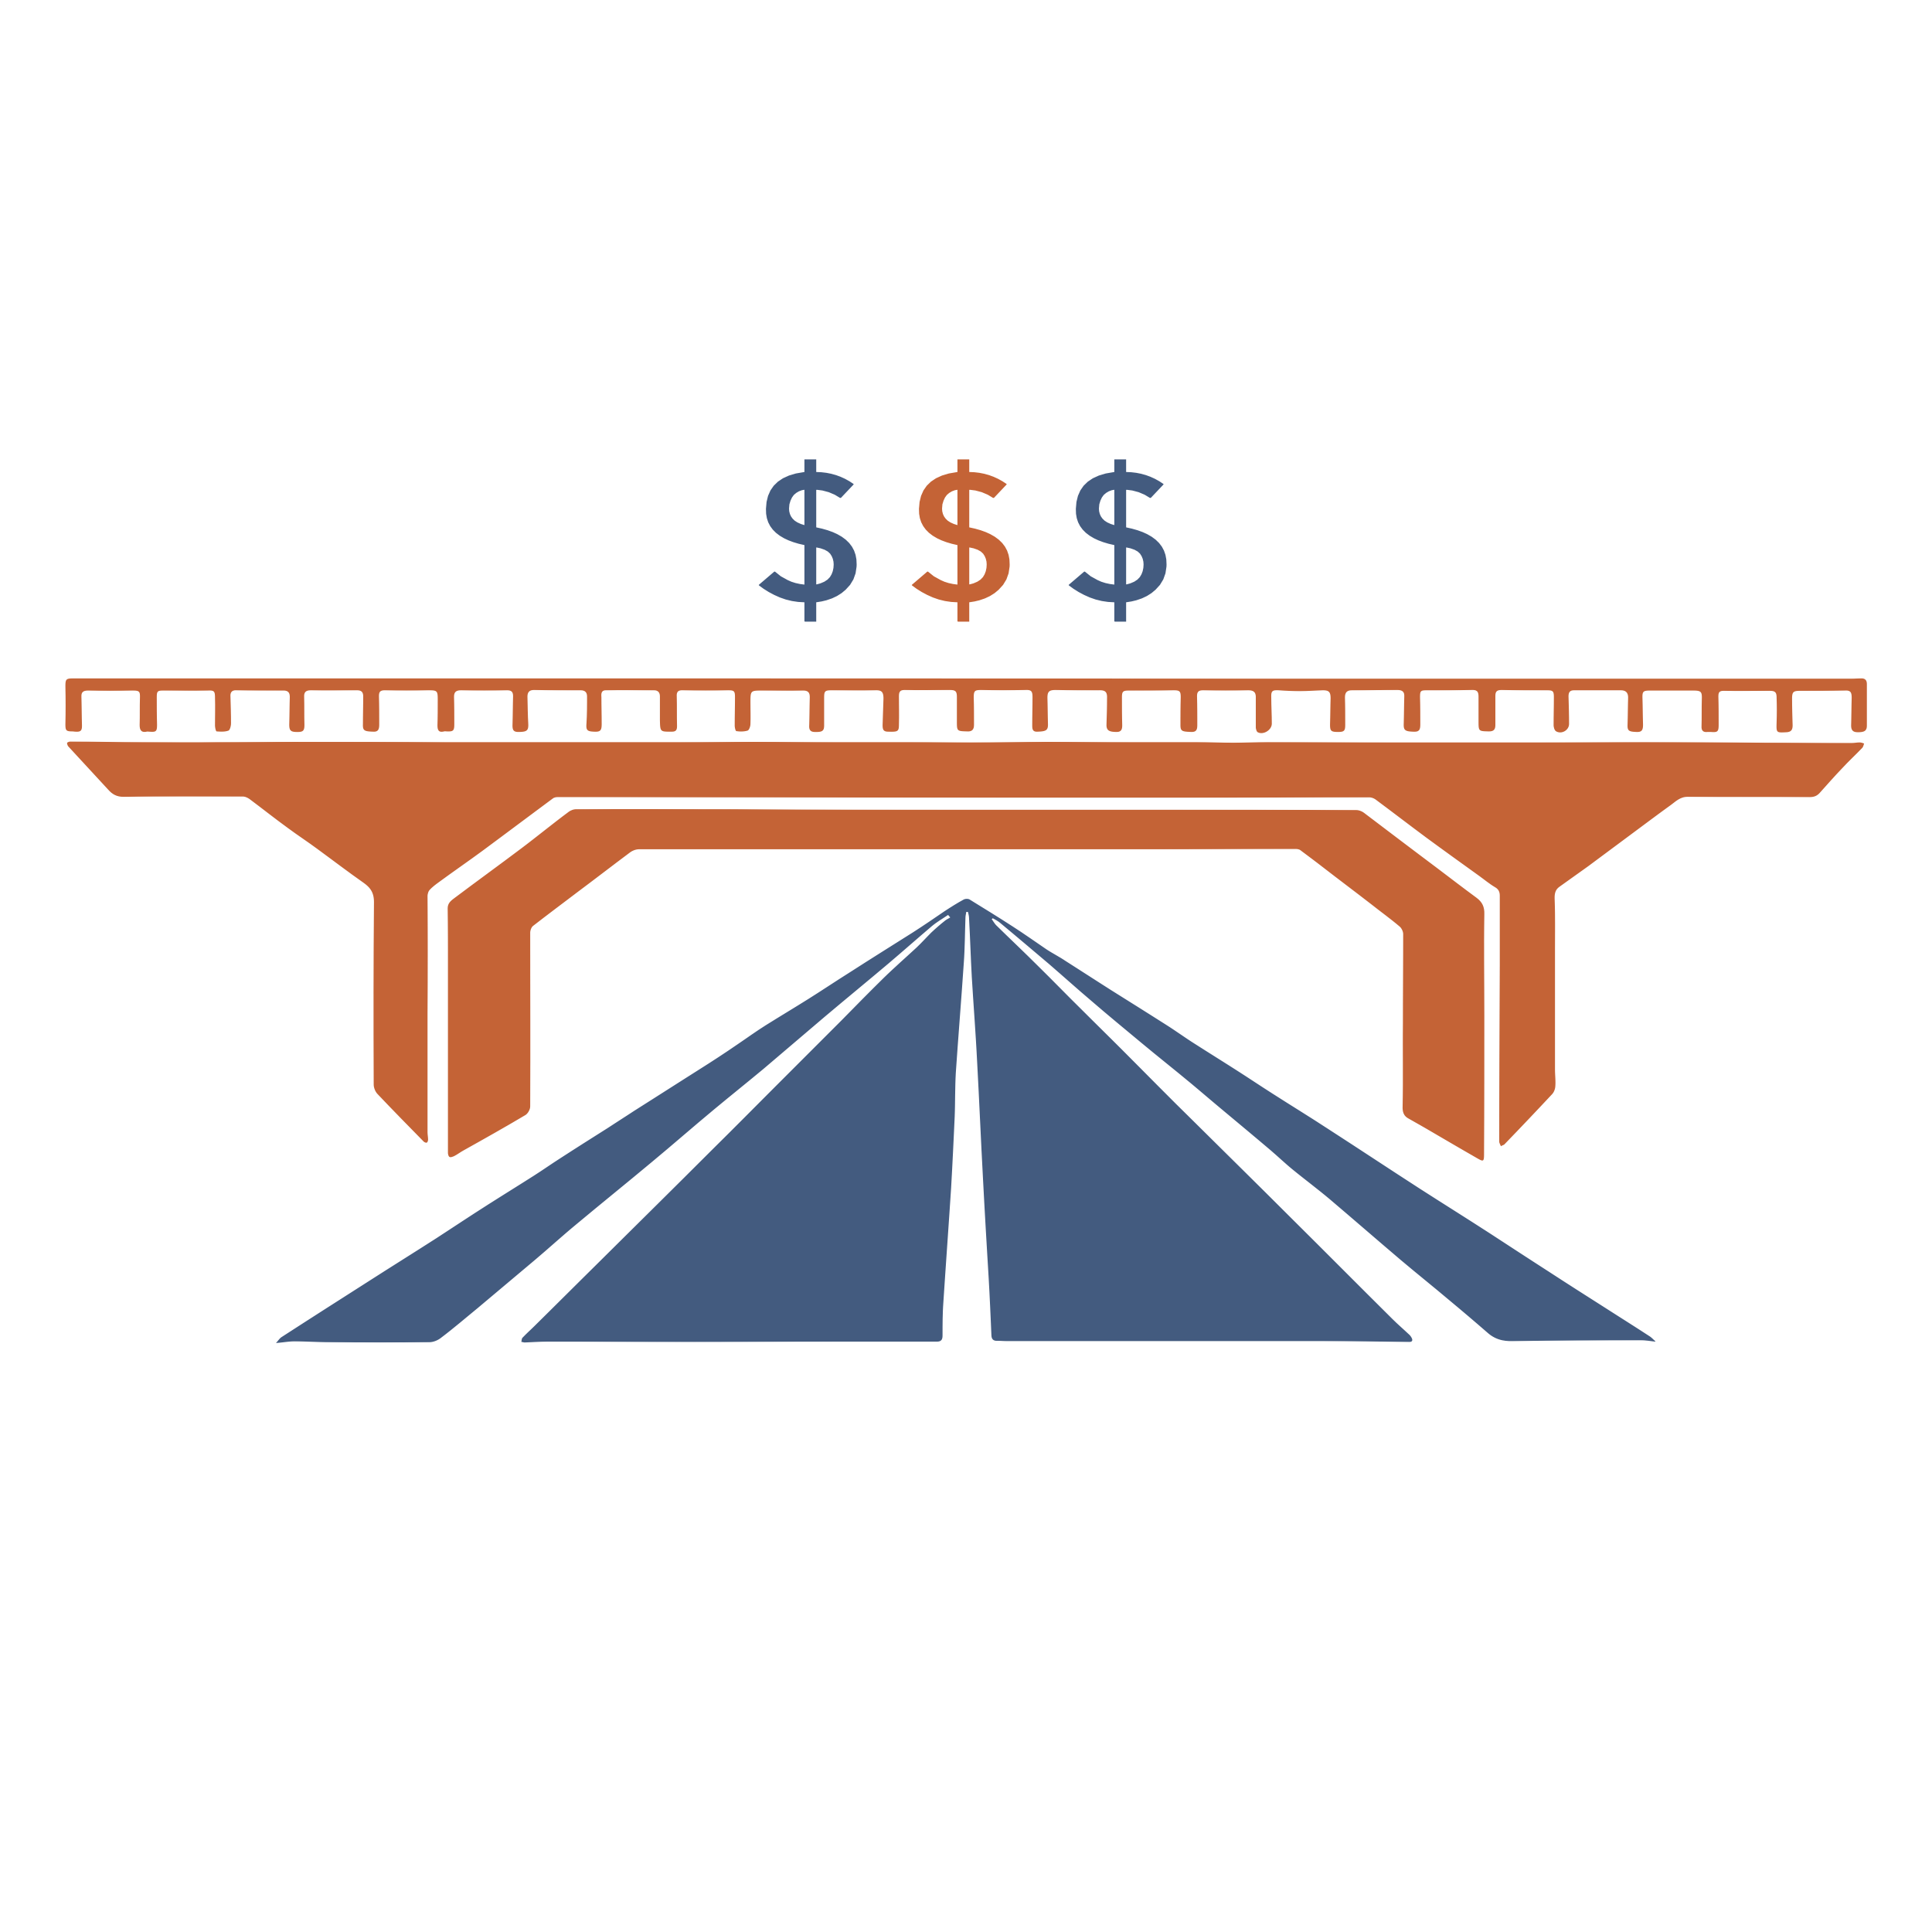
3. Maintain Essential Services & Infrastructure
Do not destroy essential state services or capital investment
We must be responsible in our spending and continue to cut unnecessary expenses while supporting the essential needs of Alaskans
Investment in infrastructure, deferred maintenance and quality education is critical for future economic growth
Three Keys to Fiscal Responsibility – Maintain Essential Service & Infrastructure

Slide 9
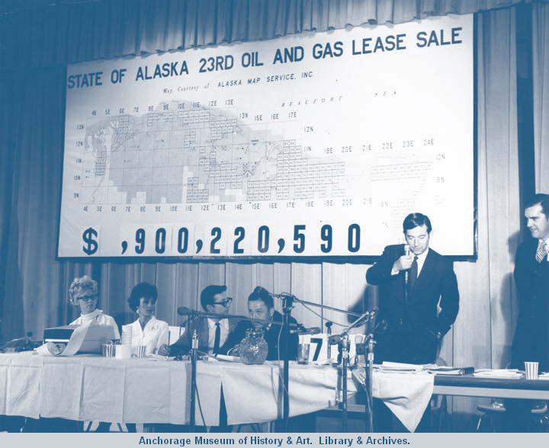
Historical Context
Understanding the path that has led us to our current fiscal situation is essential to making responsible decisions about our future
The Permanent Fund
Revenues & Expenditures
Surpluses & Deficits
Oil Price & Production
The Dividend Program
Historical Context

Slide 10
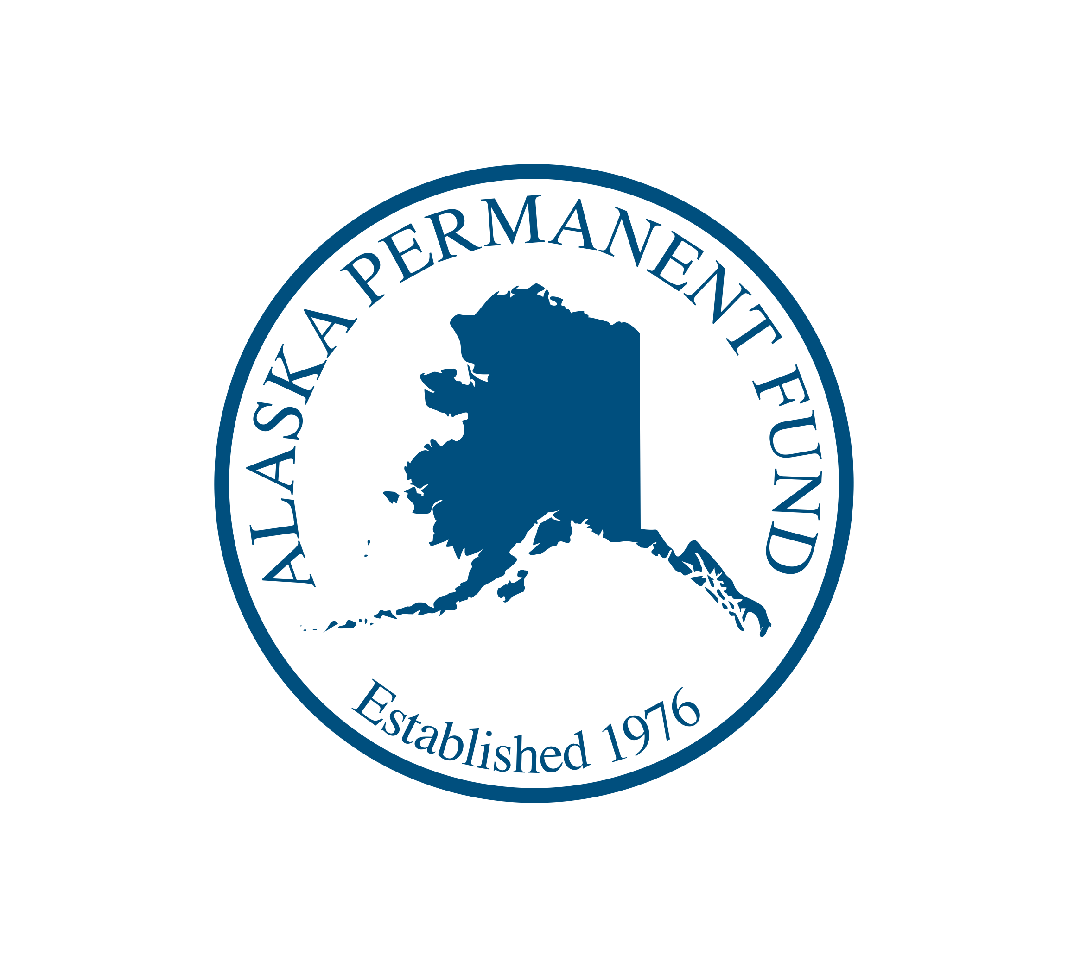
The Alaska Permanent Fund
Created in 1976 by a constitutional amendment to save and invest oil revenues for future generations
Consists of two parts:
Fund principal (savings) $63.8 billion*
Fund earnings (checking) $10.1 billion*
*As of February 28, 2022
Historical Context – Alaska Permanent Fund

Slide 11
Historical Context – Alaska Permanent Fund

Slide 12
Alaska’s Unrestricted General Fund
A simple way to understand Alaska’s budget — the UGF represents Alaska’s basic revenues and expenditures
The budget has decreased over the last decade and is now stabilized at around $4.5 billion (not including the dividend payment)
Pays for essential state services like schools, health, transportation, social services and public safety
Also pays for Dividends
Historical Context – UGF

Slide 13
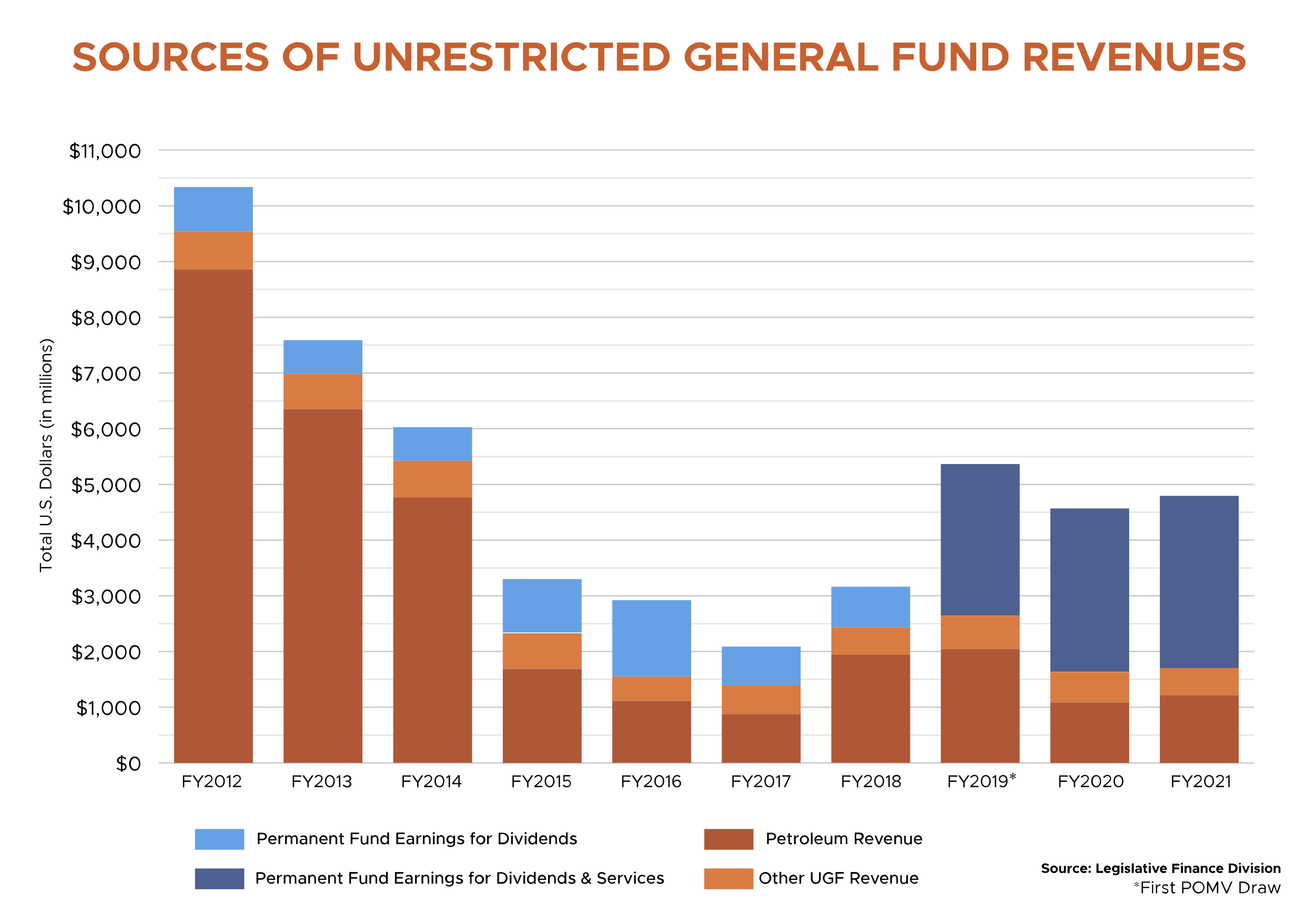
Historical Context – UGF Revenues

Slide 14
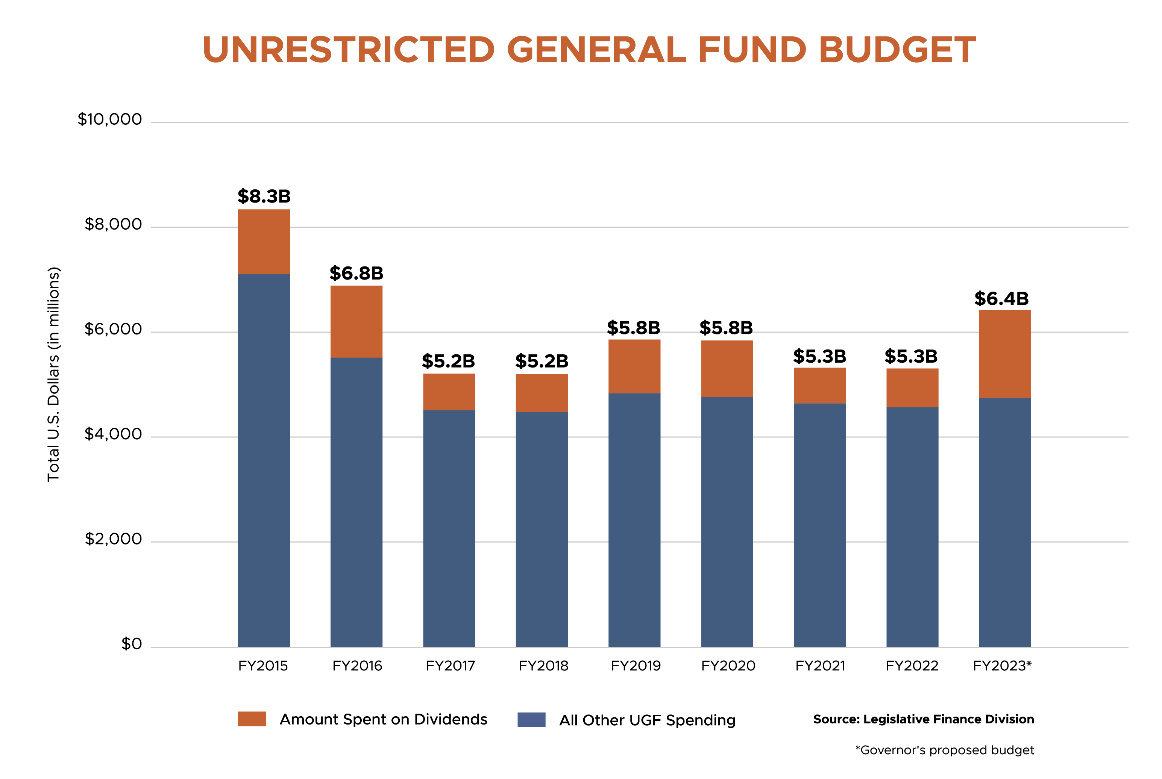
Historical Context – UGF Budget

Slide 15
The Constitutional Budget Reserve
Established by amendment in 1990
Funded by certain oil revenues and investment earnings
In addition to annual revenues and the Permanent Fund Earnings Reserve Account, the Constitutional Budget Reserve serves as a “rainy day” savings account
Needs to be replenished when oil revenues are high
In 2016, the reserve held $10.1B, but is now only $1.1B
Historical Context – CBR

Slide 16
Historical Context – CBR Balance

Slide 17
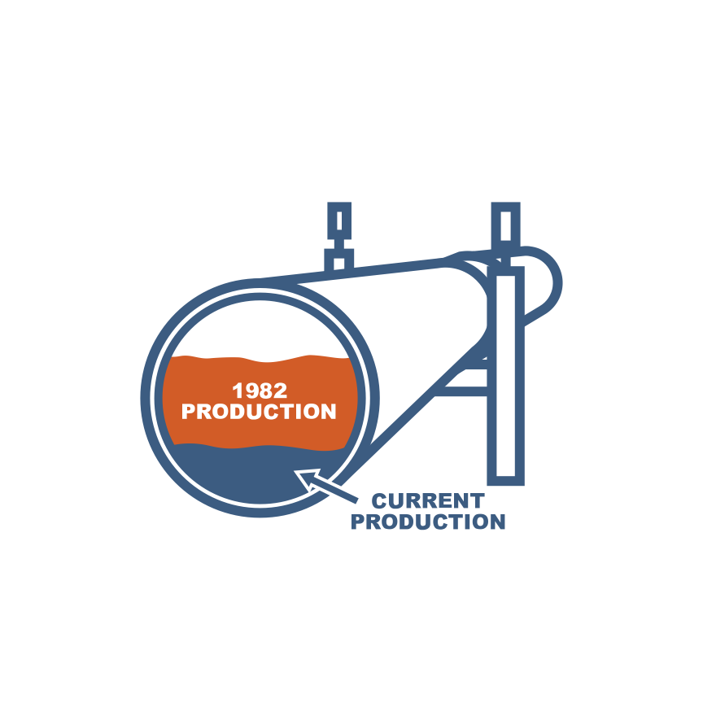
Oil Price & Production
Oil price is unpredictable and extremely volatile
Alaska’s oil production has declined significantly
We cannot realistically anticipate a return to previous production high volumes
Historical Context – Oil Price & Production

Slide 18
Historical Context – Oil Price

Slide 19
Historical Context – Oil Production

Slide 20
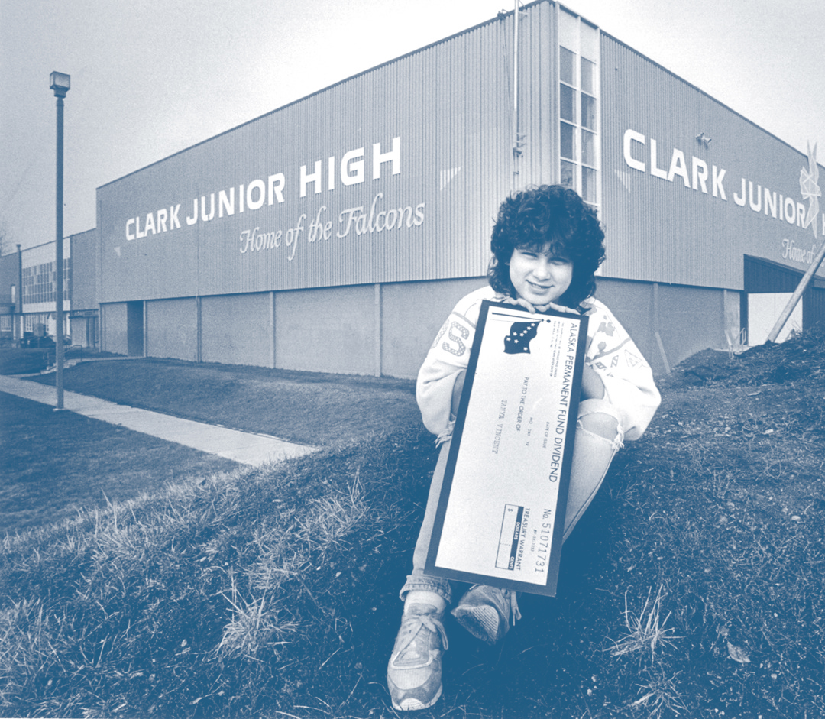
The Dividend Program
In 1980 the Alaska Legislature approved the first Permanent Fund Dividend program and the first dividend check of $1,000 was distributed two years later
Highest: $2,072
Lowest: $331
Average: $1,163
Historical Context – The Dividend Program

Slide 21
Historical Context – The Dividend Program

Slide 22
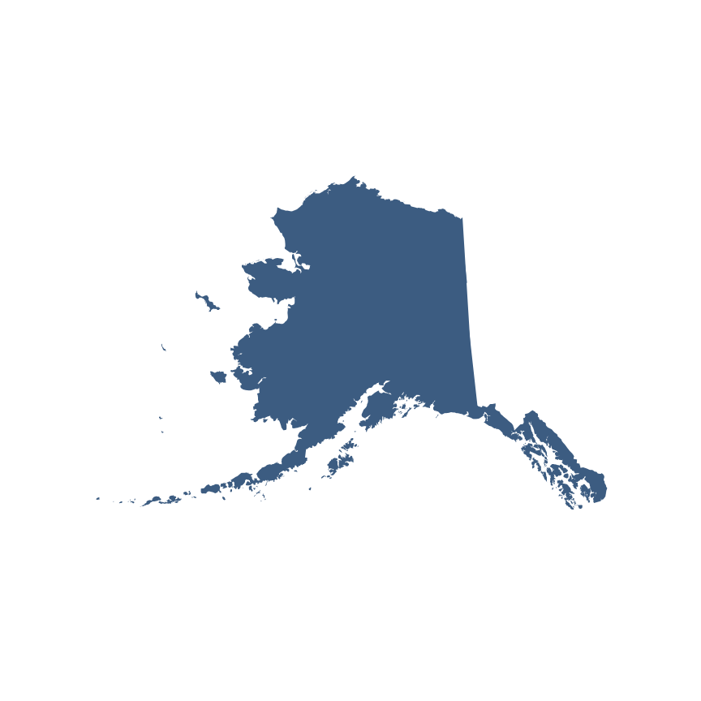
Alaska’s Fiscal Future
WE CAN HAVE IT ALL!
Low taxes
Essential state services
A strong economy
A sustainable level of PFD forever
The big issue before the Alaska Legislature is how large a Dividend can be paid going forward and how to pay for it
Paying a $1,000 Dividend costs about $635 million
Alaska’s Fiscal Future
Notes:
All levels will suffer if the state continues to burn up savings, and yet still demands an irresponsible level of dividend:
-Upper Income and Business: Will be taxed further to generate new revenue.
-Middle Income: Will be taxed.
-Low Income: Will face diminished state services that are heavily relied upon currently. This loss of services will account for far more than an oversized dividend can possibly make up for.
Once a new tax is created, it is rare for it to go away, and only too common for it to increase.
(Example: For a family of 4, with a joint income of $100,000, and a 4% income tax, would equal $4000 paid in income tax.
A state personal income tax would net approximately $500 million a year at a rate of 2% on annual gross income.

Slide 23
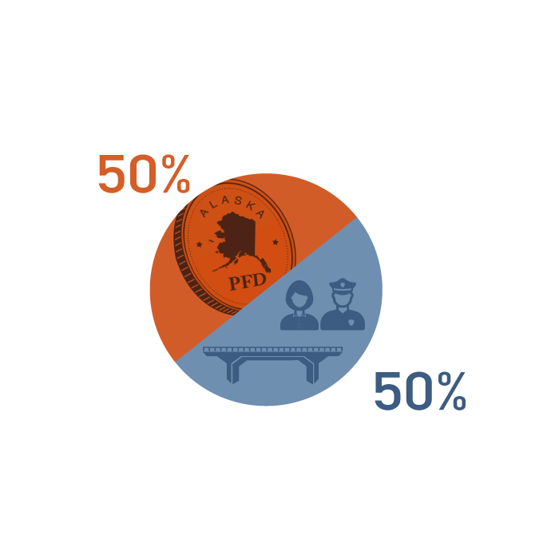
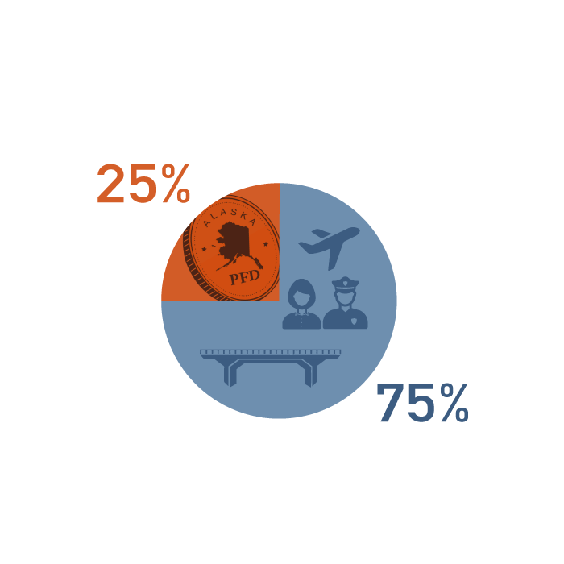
How to Split the POMV
There is broad support to continue following a structured Percentage of Market Value (POMV) draw at 5% per year. The draw is established in law, but how it should be spent is undefined
There are two proposals under consideration:
The 50/50 Plan provides for higher Dividends but increases the potential need for new revenues
The 75/25 Plan provides for Dividends and is less likely to result in budgetary shortfalls
The other option is to leave it to the Legislature to decide each year.
Alaska’s Fiscal Future – How to Split the POMV

Slide 24
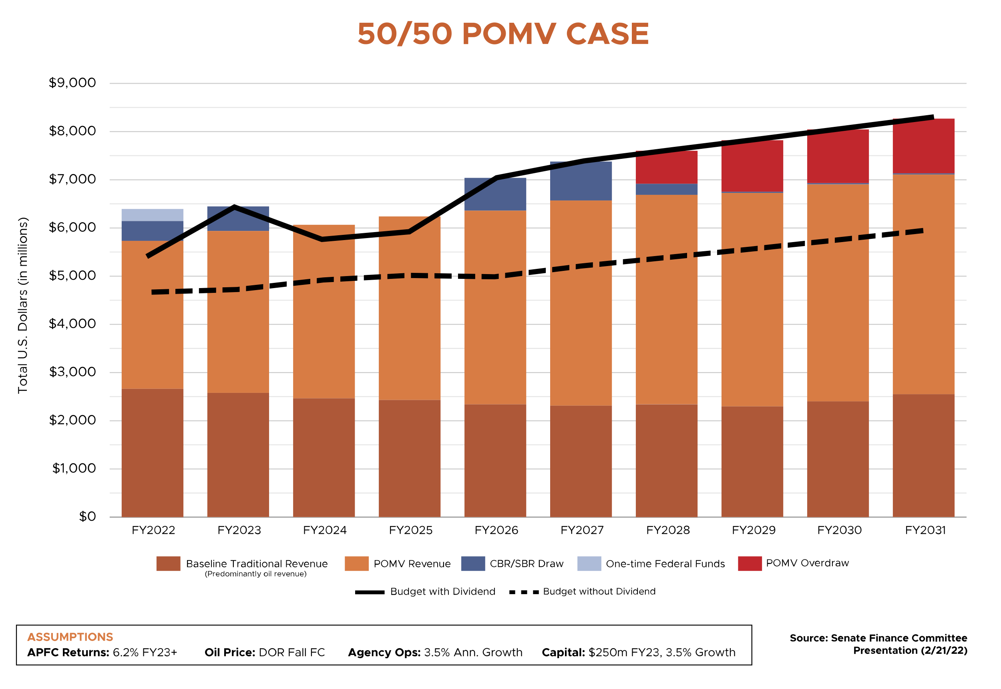
Alaska’s Fiscal Future – 50/50 POMV Case

Slide 25
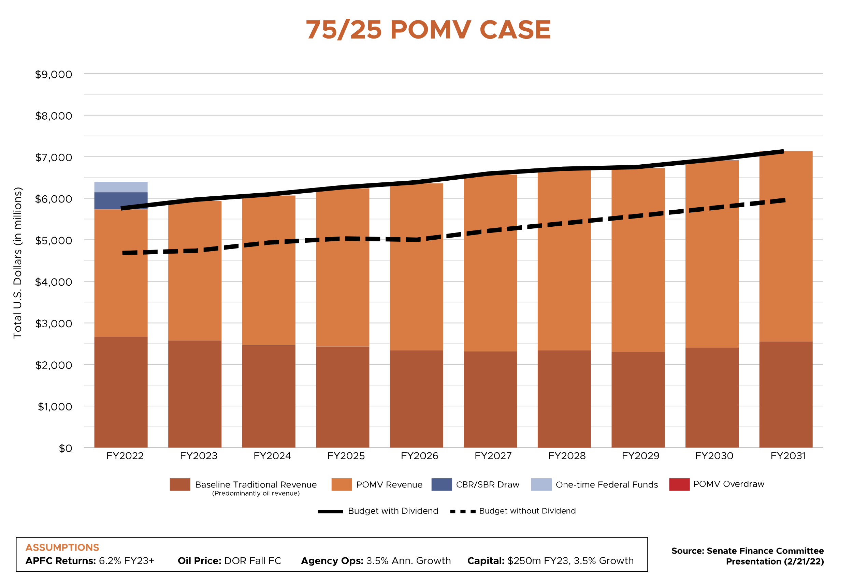
Alaska’s Fiscal Future – 75/25 POMV Case

Slide 26
The Choice is Ours
We are at a critical juncture and it is important that Alaska’s Legislature makes a well-informed choice.
What do we value?
Are we willing to pay new taxes?
Are we willing to slash essential services?
Are we willing to spend our savings now, at the expense of our children and grandchildren’s future?
Alaska’s Fiscal Future – The Choice is Ours

Slide 27
Questions?
www.AlaskansForCommonSense.com

